Slide 1
Connecting Excel to Power BI
Quick Start Guide

Slide 2
Overview: How to use the Excel PBI Matrix w/ Power BI
Overview
  The excel spreadsheet tab must not be renamed, this will break the Power BI file. You can rename the entire excel workbook without causing issues. Ex. “Scoping Matrix” to “New Project Name”.
  The PBI Matrix spreadsheet includes generic examples of modules available in an ERP and their functions.
  The PBI Matrix can have different matrix loaded into the Process, Details, Comments and change the Criteria naming/scoring to percentages to work with MSP Requirements, IT Assessment etc.
  The Power BI file (Scoping Matrix.pbix) can be renamed without causing issues to the linking to excel document.
  Leadership must determine the weighting of answers and how many weighted categories should be assessed.
  The RACI matrix assigns team members to sections to complete open items.
  The matrix may not be fully utilized due to cost or constraints; each solution must be tailored for the project.
  If sending to a vendor, they must complete their section, explaining how their software meets the defined tasks prior to interviews.

Slide 3
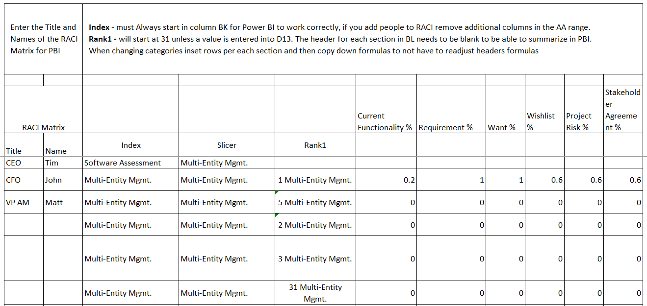
Setting up a new Project
When starting a new project, copy the entire PMO folder. Then, rename the Power BI file titled “0.4 PMO” to match the new project name. If you update the name of “0.1 PMO” Excel file you will have to update additional fields in Power Query.
Please note: The Power BI file within the copied PMO folder will still be linked to the original Excel file from the originally copied folder. This behavior is expected. To correct it, open Power Query in Power BI and update the data source to point to the Excel file in the new project folder.
The PMO PBI Matrix spreadsheet serves as a data source, with the Index and Rank1 columns starting at column BI. If columns are added or removed in the RACI or Vendor sections, ensure that any extra columns are deleted so the Index column remains in BK. Failure to do so may result in connection issues when linking the spreadsheet to Power BI.

Slide 4
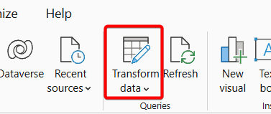
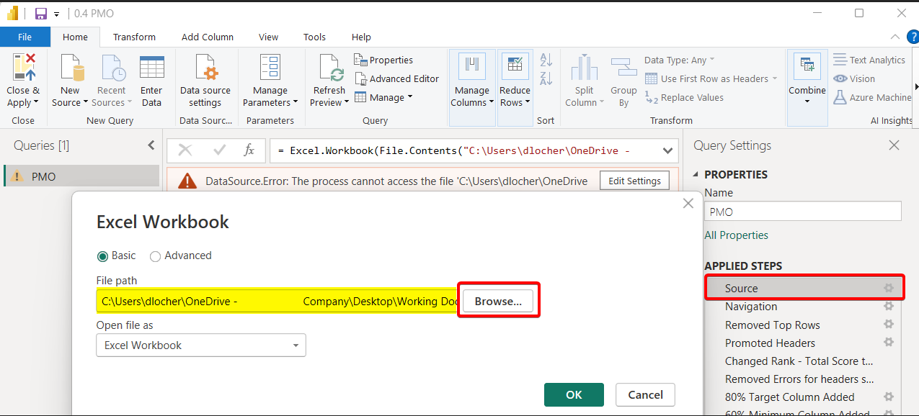
Reconnecting Power BI file to new renamed Excel
Step 1: Open Power BI in the recently copied folder and go to Tranform Data, Power Query (PQ)
Step 2: In Power Query, go to the Applied Steps pane and click the gear icon next to Source. Then, navigate to the newly copied project folder and select the renamed Excel file. If Power BI is unable to access the original file, it will display an error message, as shown in the example. Error message will clear when connected to the new excel file.

Slide 5
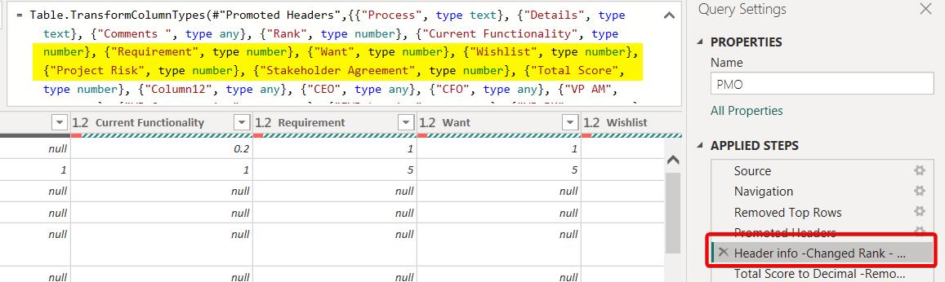
Updating Row Headers in Excel and Power BI
Step 1: Do not delete or modify rows 1–11 in the PBI Matrix. Row 11 contains the column headers used by Power BI. If you rename any values in row 11, you must also update the corresponding column references in Power BI.
Step 2: In Power Query, go to the Applied Steps pane and click the gear icon next to "Header info". Then, expand the Formula Bar to view the step details.
If you've renamed or inserted a column in Excel, locate the corresponding column name in the formula and update it to match the Excel file. If a new column was inserted, be sure to add it in the correct position within the list to maintain the expected column order.
Once the column names and order match the Excel file, Power BI will be able to refresh and load the data correctly.

Slide 6
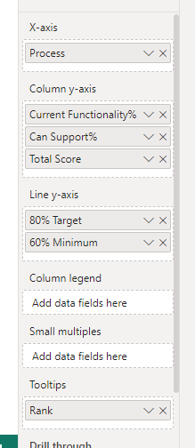
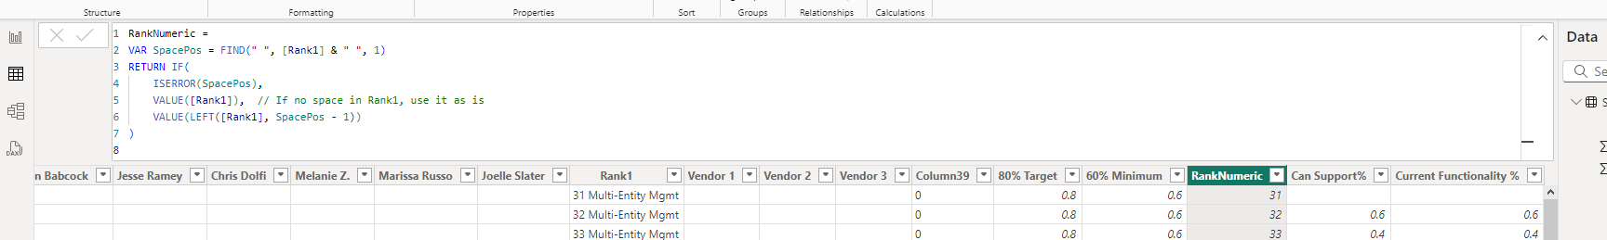
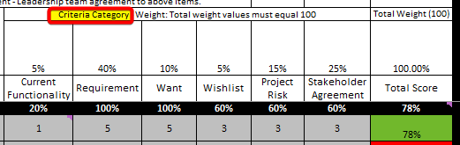
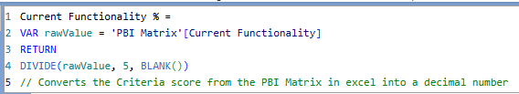
PMO PBI
Software Assessment spreadsheet is the data source for Power BI and has an index in L and a unique identifier in AL to assist with the calculations in PBI.
Power BI is summarizing each Departments software score – the software assessment slide is the summary of total score of each department. Individual departments are showing their can, current and blended total scoring.
In PBI:
80% Target column is added in model
60% Minimum column is added in model
RankNumeric:
  RankNumeric =
  VAR SpacePos = FIND(" ", [Rank1] & " ", 1)
  RETURN IF(
  ISERROR(SpacePos),
  VALUE([Rank1]), // If no space in Rank1, use it as is
  VALUE(LEFT([Rank1], SpacePos - 1))
  )
Criteria Category from PBI Matrix in Excel
  Current Functionality % =
  VAR rawValue = 'PBI Matrix'[Current Functionality]
  RETURN
  DIVIDE(rawValue, 5, BLANK())
Publish the PBI file and then in power point go to insert and select PBI and find the report to insert it into the file for presentation, select live connection so the report will refresh when opening power point each time. In the tool tips you can sort by Rank, Total score etc.

Slide 7
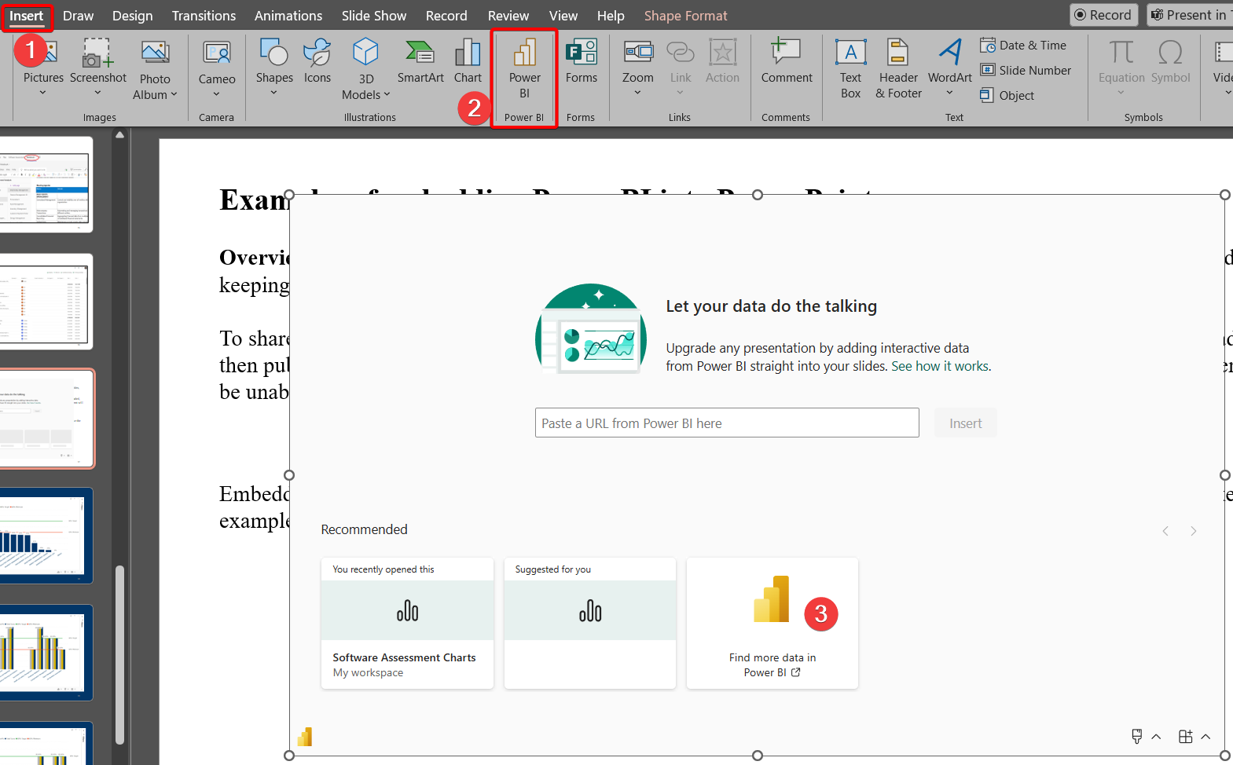
Examples of embedding Power BI into Power Point
Overview: Embedding Power BI into PowerPoint allows you to present live, interactive data directly in your slides, keeping reports up to date without manually updating data, visuals or switching apps.
To share PowerPoint presentations with embedded Power BI reports, ensure all slides are refreshed and fully loaded, then publish the file as a PDF. Otherwise, recipients without the appropriate Power BI license in your environment will be unable to view the reports.
Embedding reports requires a licensed
Power BI account. If you don’t have one,
you’ll need to go old-school like the
examples in this document – take
screenshots and paste them into
PowerPoint manually. Boo, indeed.

